Slide 1
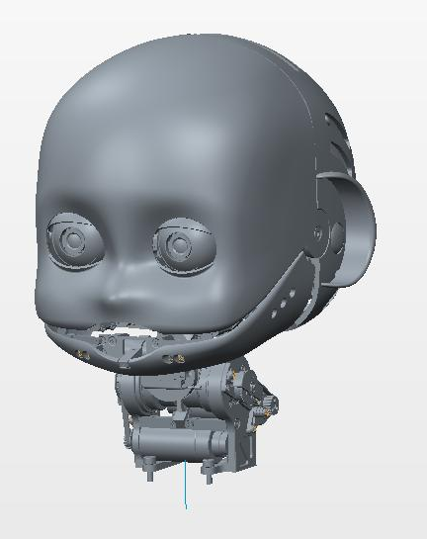
iCub3 Head joints specs
Rev. 1
05/11/2015

Slide 2
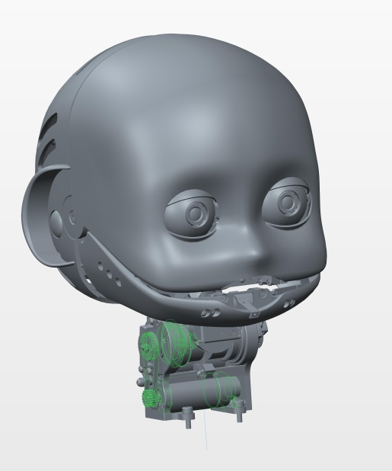
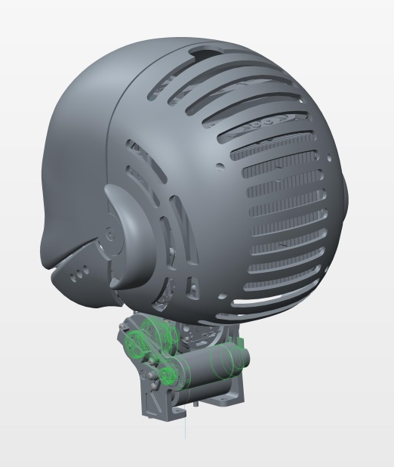
JOINTS 0 & 1 – pitch & roll coupled joints
-Motor type: DC
-Motor encoder: 512 ppr
-1° stage reduction: 18/28
-Harmonic drive: 1/100
-Last stage (cables’ pulleys reduction) 30.5/ 31.7
-AEA at the joint
-HW limits pitch (-30° +41°) roll (±40)

Slide 3
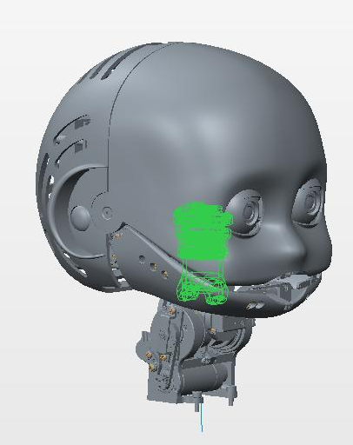
JOINTS 2 - yaw
-Motor type: DC
-Motor encoder: 512 ppr
-Harmonic drive: 1/100
- AEA at the joint
-HW limits ±45°

Slide 4
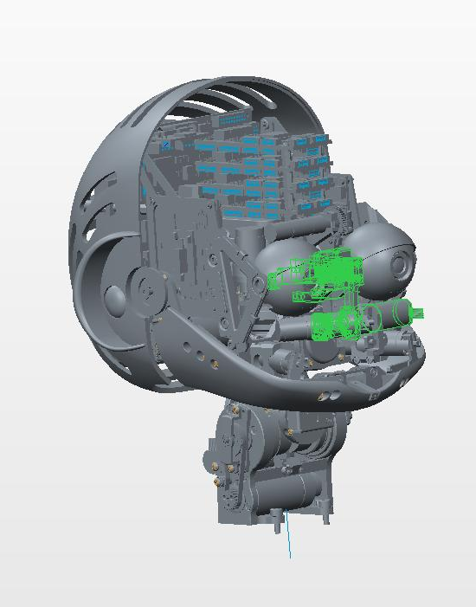
JOINTS 3 – eyes’ tilt
-Motor type: DC
-Motor encoder: 512 ppr
- Integrated gearbox 1/141
- AEA at the joint
-HW limits ±30°

Slide 5
JOINTS 4 & 5 – eyes pan
-Motor type: DC
-Motor encoder: 512 ppr
-Harmonic drive: 1/50
-No AEA
-HW limits ±30°

